Slide 1





My Growth Plan for 2024
Personal Vision
To be a product leader who consistently delivers innovative and impactful products that make a positive difference in the lives of users and maintains a healthy work-life balance.
Date: 12/31/2023
Next revision: 1/31/2024
 | Career | Growth & hobby | Health | Relationships
 | What are your career aspirations? For example: Develop and present a comprehensive product strategy to senior management by the end of Q2 2024. Receive a promotion to Senior Product Manager by the end of 2024. | What are you passionate about? How would you like to grow in those areas? For example: Write a blog post every month. Play guitar every week. Read 10 books by the end of 2024. | What are your health and fitness goals? For example: Maintain a healthy weight and running schedule (at least twice a week). Run a half-marathon by the end of 2024. | What kind of relationships do you want to cultivate? For example: Strengthen relationships with my family by having weekly family dinners. Travel together to another country by the end of Q3 2024.
 | What do you do best? What unique knowledge or talent do you have? What knowledge, talent, and skills are you lacking? How can you turn your strengths into opportunities? How is your field changing? How can you take advantage of those changes? Could any of our weaknesses prevent you from meeting your goals?
 | What new skills and knowledge do you need to acquire? What habits (e.g. continuous learning) would you like to develop? What actions do you need to achieve your goals? Break down each goal into smaller, manageable steps.
 | Who can support you in achieving your goals? Don't be afraid to share your goals with others. It might create a sense of accountability and encourage you to take action.
GOALS
SWOT
PLAN
SUPPORT

Slide 2

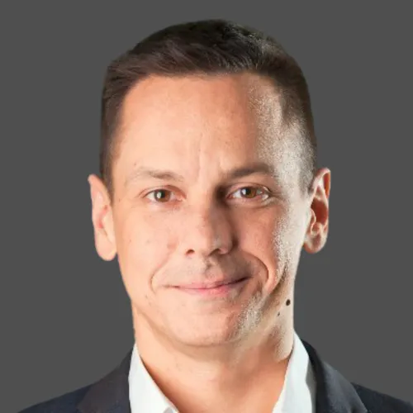
The Product Compass with Paweł
How to use this template: https://www.productcompass.pm/p/your-growth-plan-for-2024
More templates: https://www.productcompass.pm/
Join 45,000+ professionals
Get 1 actionable tip for PMs every week: https://www.productcompass.pm/
Paweł Huryn
Author, Product Coach

